Slide 1
The switch Statement

Slide 2
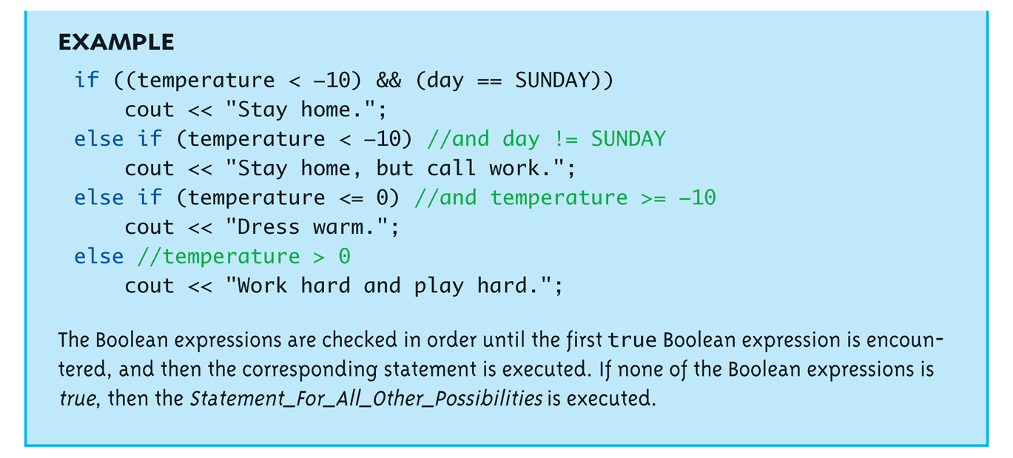
Multiway if-else Example: Display

Slide 3
The switch Statement
A new Statement for controlling multiple branches
Uses controlling expression which returns bool data type (true or false)
Syntax:
Display page 62 next slide

Slide 4
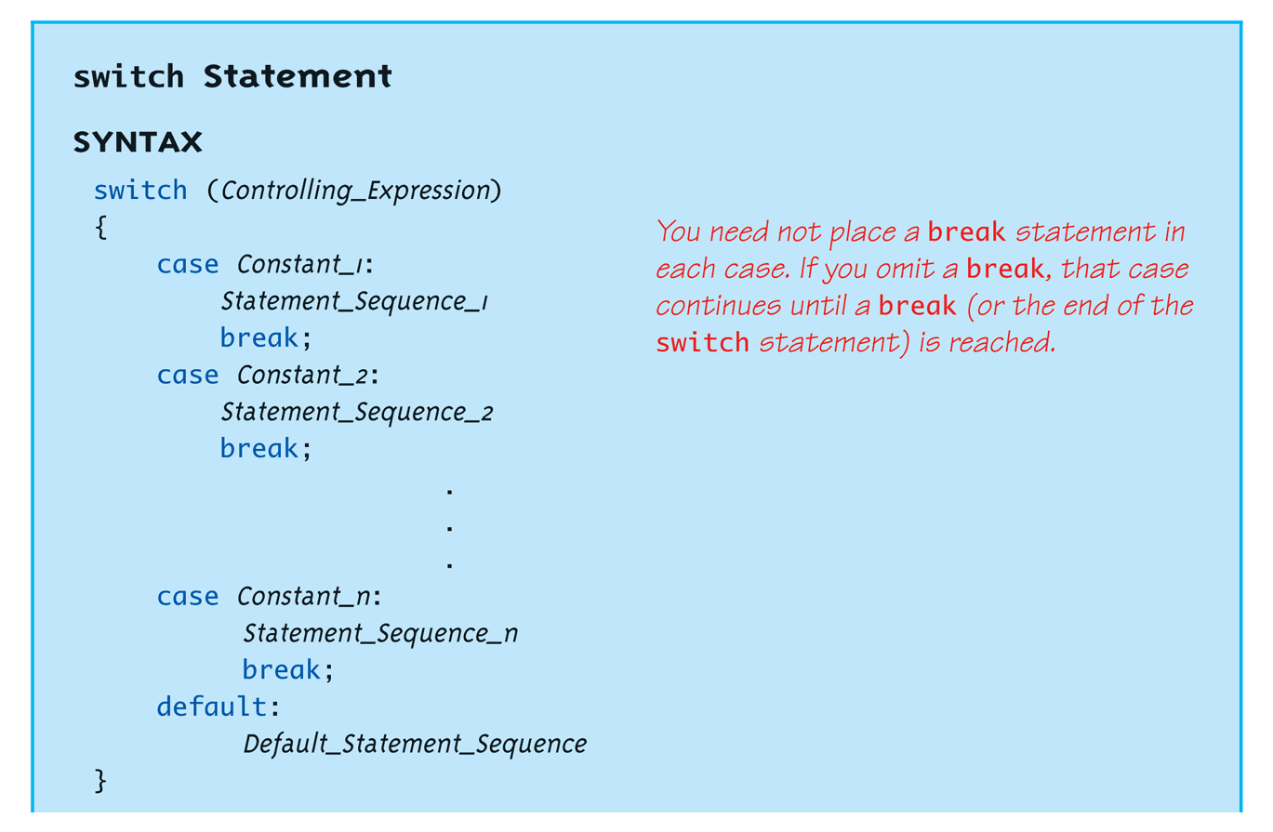
switch Statement Syntax: Display

Slide 5
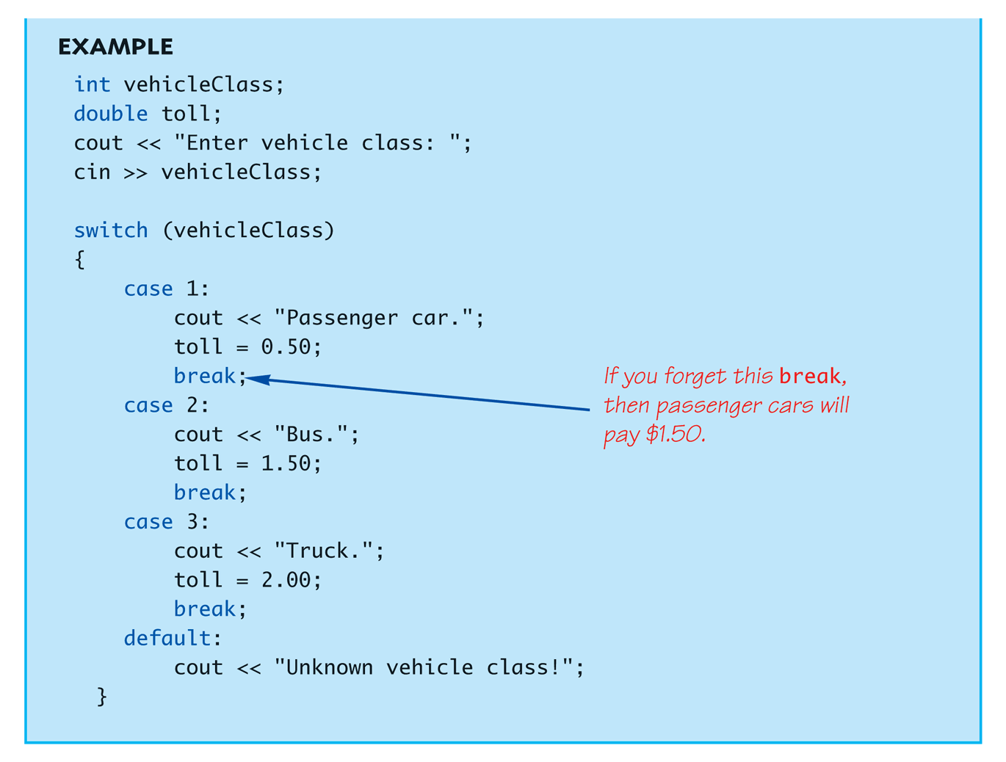
The switch Statement in Action: Display

Slide 6
The switch: multiple case labels
Execution "falls thru" until break
switch provides a "point of entry"
Example: case "A": case "a": cout << "Excellent: you got an "A"!\n"; break; case "B": case "b": cout << "Good: you got a "B"!\n"; break;
Note multiple labels provide same "entry"

Slide 7
switch Menu Example
Switch stmt "perfect" for menus: switch (response) { case "1": // Execute menu option 1 break; case "2": // Execute menu option 2 break; case 3": // Execute menu option 3 break; default: cout << "Please enter valid response."; }

